Slide 1
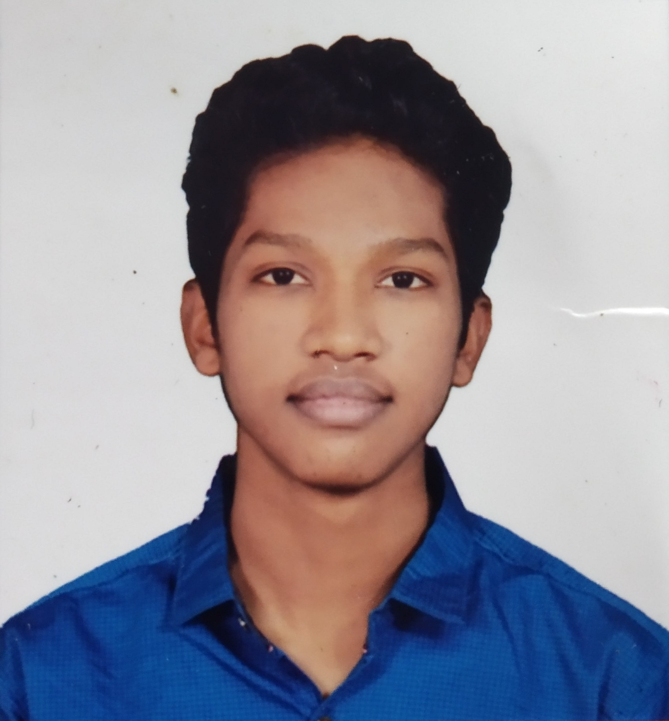



Himanshu Jaihind Wakade
Analyst/Software Engineer
Bachelor of Engineering
Electrical: 2018 - 2022
Skills
Java 8 /J2EE | Java Basics, OOPS, Generics, Collections, Arrays, Loops, Lambda Exp, Stream API Junit, Mockito, Servlets
Spring core | IOC & Dependency Injection, Autowire
Spring REST | REST controllers, Implementation of GET, POST, PUT & DELETE, Bean Validation & Exception Handling, Testing Services, Controller & Repository layer
Spring Data JPA | Implement DAO layer using spring Data repositories, Transaction Management
Spring Boot Microservices | Spring Boot Starters, annotations, Messaging Service, Sync/Async comms, Swagger API documents
Spring Cloud | Eureka, Netflix Ribbon, Feign Client, Netflix Hystrix, Netflix Zuul & Config Server
React | Components, Event handling
Angular | Components, Services, Modules, Routing, Forms & Validation, Testing using Jasmine & Karma
Database | MongoDB and MySQL
UI Tech | HTML 5 & CSS 3,JavaScript, ES6 & TypeScript Reusable templates, Optimized UI Designed
Tools | Git, Postman, Maven, IDE(Eclipse,IntelliJ,Vs code)
Devops | CI/CD, Jenkins configuration, Build Pipelines, notifications, quality gate understanding
Add On skills | Communications,Team working. Peer learning,Time management and Positive Attitude
himanshuwakade75@gmail.com
+91 7264951290
Full Stack Developer
Hands on experience in creating microservices with Springboot, Spring Security, Spring Cloud API Gateway, Eureka server, resilience 4J, load balancing, Feign
Proficient in creating Single page Web Application in Angular with Authentication with route guards, Angular reactive forms, angular routing, CSS
Hands on experience in implementing architecture with NodeJs & spring boot
Experience in creating documentation with Java docs and swagger and in unit testing using Junit, Mockito including basic code quality compliance using Sonar cube
Development experience in creating docker images and pushing to Docker Hub with containerized applications using Docker SWARM.
Online Railway Reservation System
Completed end to end case study of Railway Reservation System of Pakistan along with JWT authentication, Swagger, Logger,Eureka,Api Gateway and payment testing using Razorpay, responsive UI with Html,CSS and Angular used for user interface.
Completed ” Python Tutorial for Beginner, Java Technology: Professional course“ course at Coursera
Check out my work on GitHub & Video Profile

